Slide 1
IS 120
Intro to CSS

Slide 2
What is CSS?
Cascading Style Sheets
HTML = Structure
CSS = Style

Slide 3
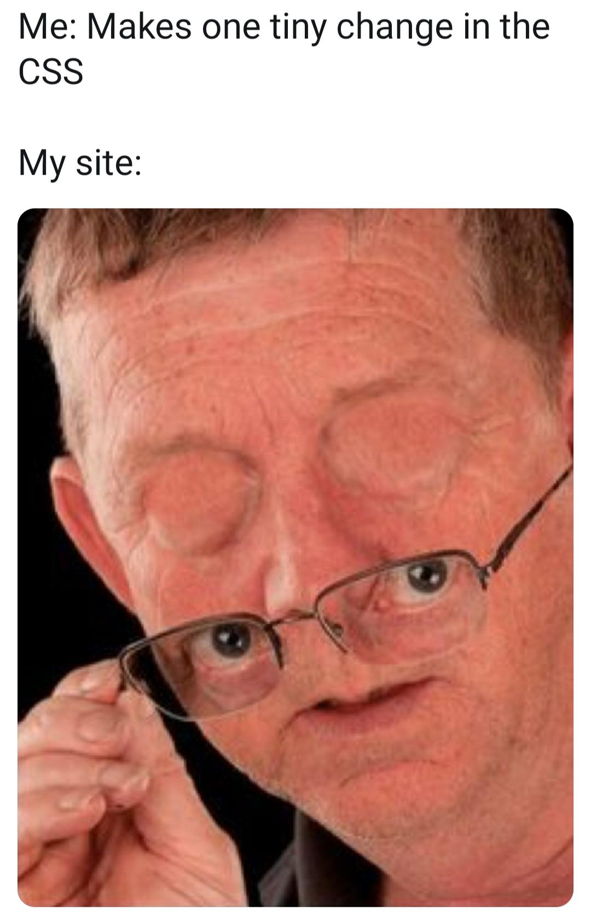

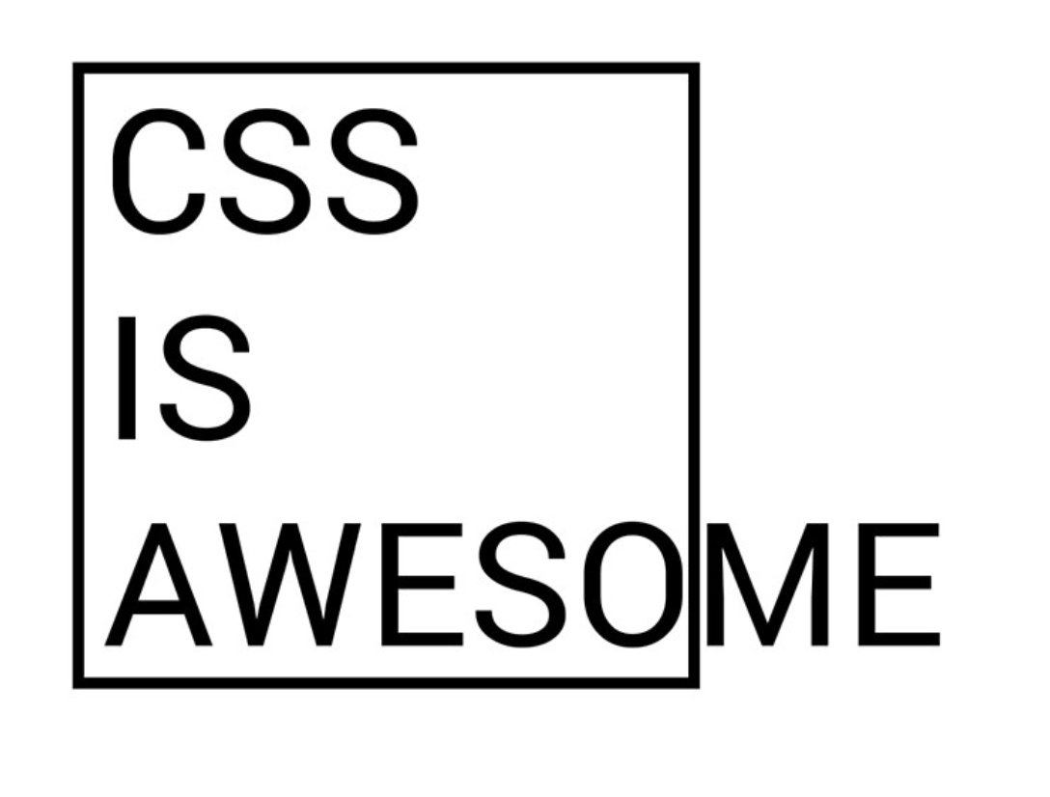

Slide 4
Why is CSS So Weird?
CSS is built to handle the nuance of web design
Video

Slide 5
Why is CSS So Weird?
CSS can be fragile, learn to use it the right way
CSS is a valuable skill, not a lot of programmers understand it well

Slide 6
Where does CSS go?
Inline
  HTML style attribute. Applies to that tag.
Internal
  HTML <style> tag. Applies to that HTML page.
External
  Imported style.css file. Applies to pages where imported.

Slide 7
Let’s go write some code

Slide 8
CSS Diner

